Slide 1

Foodeez : Small Snacker
Assignment no : 02
Pratik Jadhav

Slide 2

Agenda
To design and develop a Business Strategies for a newly opening Wada Pav shop at Shivaji Nagar, Pune.
This shop is already goanna surround with four more wada pav shops nearby.
Analyze and give solution for the current scenario in order to help the shop to grow.
Answer following questions during analysis : -
How will he differentiate from different competitions?
How will you bring insights when you have no data of shop?
Why will be the customers comes to your shop?
What will be the price of each wada pav ?

Slide 3
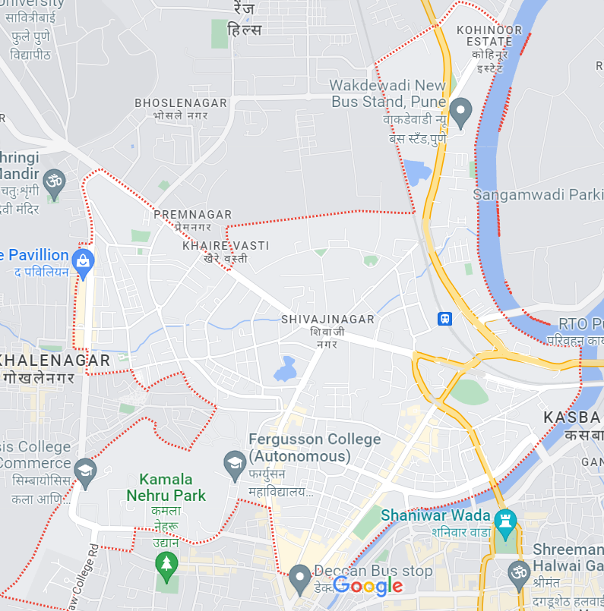
Shivaji Nagar, Pune
Location :​​
Foodeez : Small snacker,
Near Fergusson college, Shivaji Nagar,
Pune – 411004
Timing :
Morning 8 am – 1 am
Evening 4 pm – 8 pm
Foodeez : Small snacker,
Near Fergusson college, Shivaji Nagar,
Pune – 411004
Timing :
Morning 8 am – 1 am
Evening 4 pm – 8 pm
Shivaji Nagar, Pune

Slide 4
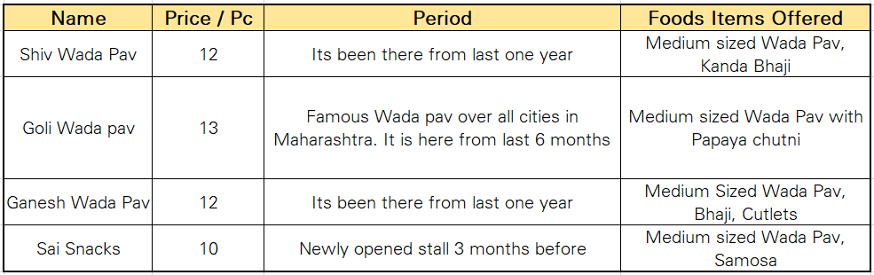
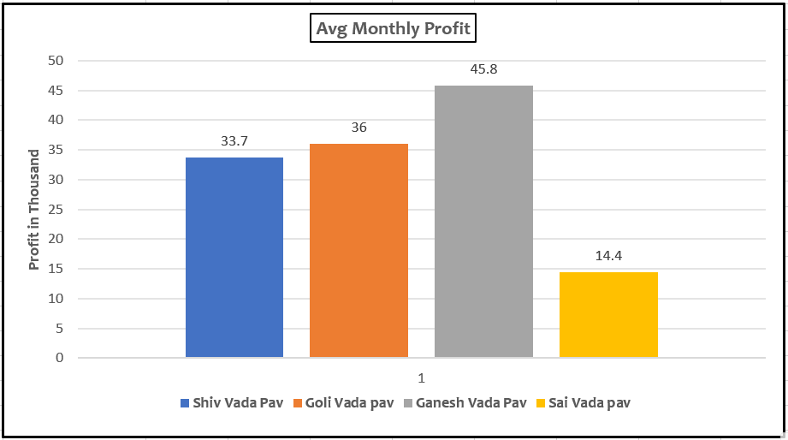
Competitors :
Four more Vada pav Shops nearby with approx. same shop timing
Below is the Business status of them.

Slide 5

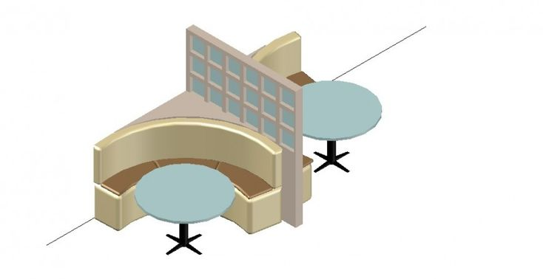

Points to be consider :
As it is very first month below certain points need to be considered during opening on shop :
Reasonable Price
Good Discount Offers over Bulk orders.
Quality of Food
Analyse the customer based on their visit times. Daily, Weekly etc.
Proper Seating Arrangements
Offer on Combo with Chai
Serve Wada pav with various condiments or dips.

Slide 6
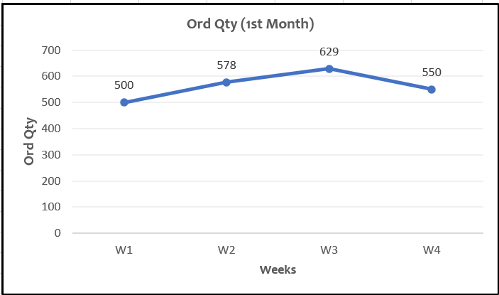
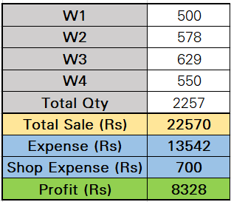
1st Month :
Investment Made : INR 300000 (Utensils, chairs, benches, light. Water)
Wada Pav Price / Pc : Rs 10/-
Order Qty Stats for 1st Month Would be:

Slide 7


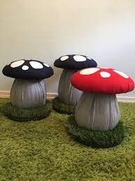

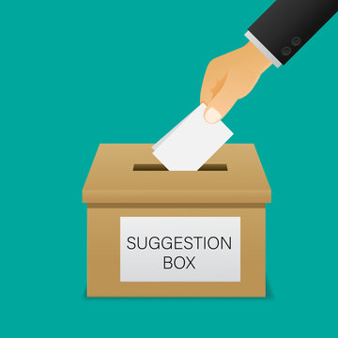
Profit Investments :
Utilize the profit gained for the business setup initially.
It can be used for:
Interesting wall stickers and Jokes to design shop.
Replace traditional chairs with attractive Mushroom chairs.
Maintain hygiene by using Gloves during cooking.
Work on proper ventilation and Kitchen exhaust.
Silent Background running music will be a game changer for targeted young customers.
It will make it there 3rd place in row after home and college.
Buy 15-20 kullads and start serving chai at same shop.
Use Reverse wada pav technique which hits curiosity among customers.
Start cold milk shakes during afternoon time period as add on.
Place suggestion box, Open for improvement and feedback.

Slide 8
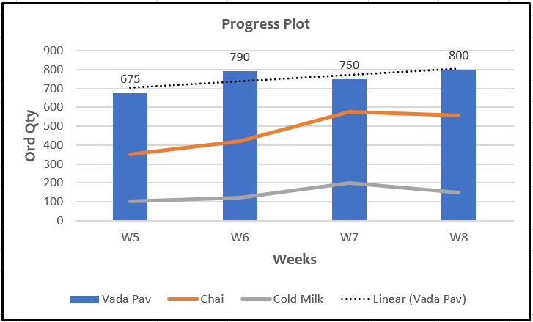
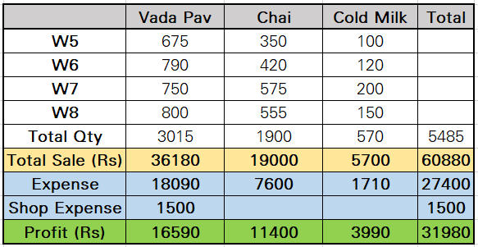
2nd Month :
As per the improvement points given / suggested we can work and look different in manner to improve business with including people interests in the business routine ex. Music, jokes, slogans etc.​
Similar growth can be seen in within next month itself of our wada pav vendor.
Wada Pav Price / Pc : Rs 12/-
Order Qty Stats for 2nd Month Would be:
​

Slide 9


